Slide 1

Fresh Fruit & Vegetable Program Training 2015
Nevada Department of Agriculture
Food and Nutrition Division

Slide 2

Welcome
To the 2014-2015
USDA Fresh Fruit and Vegetable Program
Presented by
Lara Evans MPH, RD, LD

Slide 3

AGENDA
History and Goals
FFVP Handbook
Program Administration
  Training
  Overview
  Claiming
  Recordkeeping
  Educating
  Promoting
  Partnering

Slide 4

PROGRAM HISTORY
Farm Security and Rural Investment Act of 2002
Child Nutrition and WIC Reauthorization Act of 2004
The Agriculture, Rural Development, Food and Drug Administration, and Related Agencies Appropriations Act, 2006
Consolidated Appropriations Act of 2008
The Food, Conservation, and Energy Act of 2008 (Farm Bill)
Notes:
Initially began as a pilot project authorized by Congress in 2002. The pilot provided funds to purchase fresh fruits and vegetables in 4 states and an Indian Tribal Organization for SY 02-03. The purpose of the pilot was to determine the best practices for increasing fruit and vegetable consumption.
The success of the pilot led to legislation in 04 to expand the program and make it permanent. 4 additional states and 2 Indian Tribal Organizations were added.
In 2006 The Agriculture, Rural Development, Food and Drug Administration, and Related Agencies Appropriations Act appropriated a one-time funding of $6,000 to further expand the FFVP in 6 additional states.
The 2008 Consolidated Appropriations Act expanded the FFVP nationwide and provided approximately $9.9 million to begin program operations for SY 08-09. Also in 2008 The Food, Conservation, and Energy Act amended the Richard B. Russell NSL by adding Section 19, the FFVP. Section 19 permanently authorized the program nationwide, consolidated all prior operations under Section 19 and provided a significant funding increase beginning in FY 2009 of $40 million.

Slide 5


GOALS OF THE FFVP
Create healthier school environments.
Expand and increase the variety and amount of fruits and vegetables children experience and consume.
Combat childhood obesity by helping children learn more healthful eating habits (through the consumption of healthy foods and nutrition education).
Notes:
This program is seen as an important catalyst for change in efforts to combat childhood obesity by helping children learn more healthful eating habits.
The FFVP introduces school children to a variety of produce that they otherwise might not have had the opportunity to sample.

Slide 6

Fresh Fruit & Vegetables Program Handbook
A link to the handbook and other USDA resources is on the NDA website
The latest edition was released December 2010. Ensure you have the latest version of the handbook. As new versions are released, the new guidance becomes effective immediately.
Notes:
The most current handbook (2010) is available on both the USDA’s Child Nutrition Programs website as well as Nutrition section of NDA’s Website

Slide 7
FFVP: Required Annual Training
Each SFA/participating school is required to have at lease one administrative employee “attend” annual training provided by NDA
  Food Service Management Company employees are welcome to attend, but this will not meet the SFA/School training requirement
Year 1: Attendance of live training is mandatory
Year 2+: Can attend live training or webinar training
Appropriately train school staff
  Kitchen, teaching, and support staff
Notes:
Each year, the designated FFVP administrative employee at both the SFA and school level is required to attend training.
SFA Level – this could be the School Nutrition Director, Assistant Director, or other designated staff that will be responsible for program oversight and claims.
School Level – this could be the Principal, Assistant Principle, or designated staff that will be responsible for implementing and managing program in the school
1st Year: For any responsible administrator (SFA or School) who is new to the district or a participating school, it is mandatory to attend the live training for their first year
2nd + Year: Can attend the live training, or can opt to take training webinar online and complete quiz.
REMEMBER: You need to appropriately train and support the school staff as well, it’s not just the administrators and food service management staff who need to know the rules of the program
FFVP is usually served in the classrooms, so you need to train not only the kitchen, but the teaching and support staff
For maximum program success, you need to have the buy-in of all those involved, especially the teachers who are being asked to incorporate the program into their lesson plans
Make sure to document all those who received this training (agenda, training materials, and sign in sheets)

Slide 8

FFVP: OVERSIGHT
USDA NDA SFA SCHOOL
Each individual school must fill out their own application information
  This will become even more important as more schools apply and the program becomes more competitive
Schools are awarded the program and the funding, not the School Food Authority
  This means that each school will receive a different allotment based on their enrollment
Notes:
Oversight begins with the USDA which then moves down to the State Agencies – which in Nevada is the Dept. of Agriculture-Food and Nutrition Division.
The next level of oversight is the SFA’s for each district and then the individual schools
Each school needs to fill out their own application; blanket answers are strongly discouraged
As more schools apply, the more competitive the selection process will become
Schools are awarded the program, and the funding, not the SFAs
This means that the district is not working with a lump sum for the whole district
Each school receives it’s own allotment amount based on their enrollment numbers from the October FR Report
Each school has to spend their monies following program guidelines
SFA are responsible for oversight of claims being turned in and then submitting the final site and district consolidated claims

Slide 9
SELECTED SCHOOLS
Agree to make free fresh fruits and vegetables available to all enrolled children
Provide fresh fruits and vegetables during the school day.
Widely Publicize with the school the availability of free fresh fruits and vegetables.
Have documented support of the Foodservice Manager, Principal and district Superintendent.
Have 50% or more free and reduced
Notes:
This is agreed upon at the time when the schools submit their applications and is binding when awarded the grant.

Slide 10


WHO CAN RECEIVE FRUITS AND VEGETABLES
  Any child who is enrolled in the school and who is present during the meal service may participate.
  Cannot be used as gifts or rewards. You cannot withhold participation to discipline students.
Notes:
All children who are enrolled in a Elementary School.
Includes split-session kindergarten class, or a child care center located in your school are eligible for the FFVP.

Slide 11

BEST TIME TO SERVE
During school activities
Offer multiple times a day
  Morning break
  Afternoon break
During classroom time to incorporate service with a lesson plan
Notes:
Your school has the flexibility to schedule FFVP during the school day and at a school activity during the day for the students at the participating school.
Many schools serve fruits and vegetables multiple times during the school day so different groups of students have more access to fruits and vegetables.
The FFVP cannot be served during the lunch or breakfast reimbursable meal service periods.
The FFVP cannot be used to replace foods that are part of the reimbursable school meal.
Multiple distribution times/locations may be used and may be the best way to maximize participation.

Slide 12

BEST PLACE TO SERVE
Inside classrooms
In hallways
At kiosks
School’s office
As part of nutrition education activities
Notes:
The most successful distribution areas for the FFVP will be places where children can easily reach the fruits and vegetables.
The technique you use will depend on a number of factors.
Consider grade level
Student maturity
Time available and staffing availability.
Offering fruits and vegetables to children in their classrooms helps to reduce messes, deal more effectively with disruptive behavior and make the most of learning time.
Serving from kiosks lets you offer more choices and allows easier access.
Consider staggering access to lessen confusion in hallways.
Be sure to serve fruits and vegetables that can be handled easily.

Slide 13

WHICH FRUITS AND VEGETABLES
What is allowed
  Fresh fruits and vegetables
  Introduce children to new and different fruits and vegetables
  New: Kiwi, star fruit, pomegranate
  Different: Pears example – Bartlett,
  Bosc, and Seckel
Notes:
The FFVP goals are to…
Introduce new and different FRESH fruits and vegetables
Show children that fresh fruits and vegetables are healthy and tasty alternatives to unhealthy, processed snacks (high in fat, sugar, or salt)
The produce served should be presented in such a way that it will be easily recognized for what it is
If pre-chopped/packaged produce has been chosen; try to have a few whole fruits or good color pictures to show them what the original fruit looks like
Children should be able to connect to fruits like ripe peaches and crunchy apples without dips; encourage children to enjoy fruits as they are.
Slicing whole fruits and vegetables may make them easier for younger children to eat
Adjust the offered selections to serve the students’ favorites, but also continue efforts to introduce new items.
Consider more pre-cut fruits and vegetables and pre-prepared trays in order to control labor costs and handle lack of extra storage space.

Slide 14
WHICH FRUITS AND VEGETABLES
What is LIMITED
  Dips for vegetables (serving size ~ 1-2 tablespoons)
    Low-fat, non-fat, or yogurt-based dips
    Salad dressing (low-fat) when taste testing lettuce greens
  Cooked vegetables
    Limited to once-a-week and MUST be part of a nutrition education lesson
    Only fresh vegetables that are not normally eaten raw may be cooked
    May not claim any additional ingredients that are part of the cooked fresh vegetables dish
Notes:
Dips should be pre-portioned and must be low in fat or non fat. Yogurt based dips are encouraged.
**Note: although it’s often healthier - the ingredients used to make dips from scratch are not allowable costs to the program

Slide 15

WHAT IS NOT ALLOWED
  Processed or preserved produce
  Dip for fruit
  Fruit leather
  Jellied fruit
  Trail mix
  Nuts
Cottage Cheese
Fruit or vegetable pizza
Smoothies
Most non-food items, except those allowed under administrative or operational costs

Slide 16

DISPERSEMENT OF FUNDS
Funds for the FFVP are dispersed two times during the Grant period.
July – Must be obligated by September 30th.
October – Must be obligated by June 30th.
This is in accordance with the Federal Fiscal Year.
Notes:
Funds are dispersed two times a year in the FFVP.
Funds dispersed in July at the beginning of the grant period are considered start up money for your programs.
Since most of Nevada schools are not year-round anymore, this a good time to claim the administrative costs for planning, buying paper goods and supplies, and purchase of needed equipment (after submitting a request)
These funds must be obligated by September 30th, the end of the Federal Fiscal Year.
The second allotment of funds is dispersed on October 1st.
This is the time period in which most programs start running throughout the year; majority of cost should be the fruits and vegetables
These funds must be obligated by June 30th.
Funds not obligated by the end of their respective time periods are sent back to USDA
Costs claimed for reimbursement cannot cross into different fiscal years

Slide 17
HOW IT WORKS
Schools develop an implementation plan involving teachers and other school staff to decide when, where and how they want to implement the program and what mix of fresh fruits and vegetables they want to offer the children
Schools submit monthly reimbursement claims of allowable costs
Notes:
This is different from your NSLP claim in that your reimbursement is not based on program participation or the number of students who participated in receiving the fresh fruit and vegetables.
Planning school wide is an integral part of the program. This should be viewed as a school initiative, not a food service offering. The idea is to get the program infused in the school environment and curriculum.

Slide 18

CLAIMING COSTS
Costs to be claimed for reimbursement must be claimed at the time of purchase, not the time of use.
If grant monies are expended prior to the end of the scheduled school year, please notify State Agency.
Notes:
With the FFVP, costs are claimed when the costs are incurred.
For example… if you purchase produce on the last day of January for service in February, the cost of the produce purchased should be submitted on the January claim.
If you pull items from your stock for the FFVP that were previously purchased in another month, these costs cannot be claimed.
They must be claimed at the time of purchase.

Slide 19
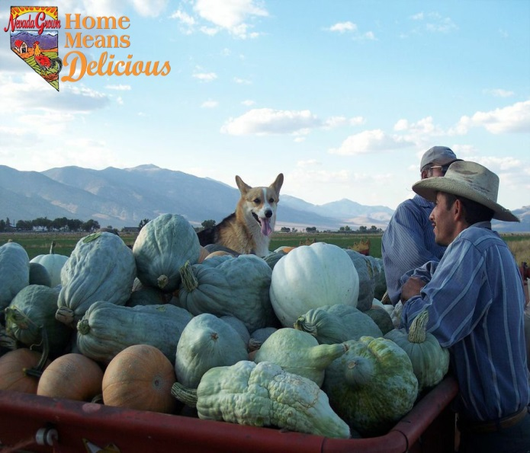
PURCHASING LOCAL
    USDA and FNS encourage local purchasing by schools for FFVP
    Produce must always be graded and inspected according to existing local, State and Federal guidelines
    School Food Authority decides who is an approved vendor
    Handle local whole produce the same way you handle whole produce from a regular distributor

Slide 20
KEEP IN MIND:
    Most farms will only have whole produce to sell. You’ll need to prep it into ready to eat snacks
    Apples are easiest for this reason and orchards often like to sell smaller-sized apples
    Partnerships with local kitchens, food co-ops, or caterers can help

Slide 21

FOOD SAFETY
Food safety is a priority in the FFVP.
Training: hand washing, cleaning and use of equipment, proper washing of fruits and vegetables, storage of leftover items, etc.
HACCP plans and SOP’s
Notes:
Preventing or reducing the risk of food-borne illness or injury by contaminated fruits and vegetables is a priority in the FFVP.
Documented training of all staff involved in the preparation and distribution of the program should be maintained.
Review your HACCP plan and corresponding SOP’s to ensure that all areas of preparation delivery to a location outside of the cafeteria and methods of service you are utilizing are included.

Slide 22
Reimbursable Costs
Two types of costs:
  OPERATING
  ADMINISTRATIVE
Notes:
Program costs are broken out into two categories: operating and administrative.

Slide 23


OPERATING COSTS
Documented costs to implement FFVP
Include:
    Cost of Fruits and Vegetables
      Low-fat / non-fat dip for vegetables only
      Delivery charges (if any)
    Nonfood supplies
      (ie) napkins, paper plates, serving bowls, trash bags, gloves, etc.
        Paper cups not approved item
          Exception if used to portion out to young children
    Labor for preparing and serving
        Direct labor and non-food items should account for no more that 25% of the total school grant
Notes:
Operating costs are the documented costs of running your FFVP service.
Operating costs include:
Fresh Fruit and Vegetables and Low-fat or non-fat dip for vegetables
Value added services such as pre-cut produce, ready-made produce trays and delivery charges
Nonfood items such as napkins, paper plates, serving bowls, trays, cleaning supplies and trash bags
Labor cost for salaries and fringe benefits for employees who wash and chop produce, prepare trays, distribute produce to classrooms, set up kiosks and clean up.
Labor and non-food items should account for no more than 25 percent of the total schools FFVP grant.

Slide 24
ADMINISTRATIVE COSTS
Administrative Costs
  Limited to 10% of your total FFVP grant per school allotment.
  Large equipment such as refrigerators, coolers, small and large carts, and food bars, etc.
  Wages and benefits for employees who compile and maintain expenditure reports, other financial reports, plan and write menus, order produce, track inventory, and coordinate nutrition promotion activities, etc.
Notes:
Administrative costs are the documented expenses you have for planning the program, managing the paperwork, obtaining the equipment you need, and all other aspects of FFVP that are not related to the preparation and service of fruits and vegetables.
Administrative cost includes:
Purchase or lease equipment needed for the FFVP
Salaries and fringe benefits for admin. costs
Administrative costs can be reimbursed up to 10% of the total grant allotment awarded to the school.

Slide 25
BUDGETING COSTS
To facilitate efficient management of FFVP, it’s highly recommended that pre-planning is done:
  (ie) some kind of spreadsheet planning out spending and ordering for each school
    Include # enrolled + classroom teachers
    Expected nonfood items
    Any labor cost with formulas built in to easily factor labor cost each month
    Same for any other prorated expenses
      Make sure your administrative expenses are reasonable and kept to a minimum – remember 10% max for admin.

Slide 26
WHAT IS NOT REIMBURSABLE
Nutrition Education Materials
  Take advantage of the free resources out there.
Promotional Costs
  Work with local distributors, farmers, recruit volunteers to help create promotional items, posters, etc.
  Children can create posters as part of a nutrition education lesson and display them around the school.
Travel
http://nutrition.nv.gov/Programs/Fresh_Fruit_and_Vegetable_Program_(FFVP)/

Slide 27
OVERSIGHT & MONITORING
Smooth operation, Schools should:
  Establish an operational plan
    Make sure that involved staff understand who does what, when, where
  Establish a monthly budget
    Know what you need/will spend monthly to ensure timely expenditure of program funds
      Prevent overspending
        Running out before end of school year
  Pay attention to logistics and modify as needed

Slide 28
OVERSIGHT & MONITORING
It’s critical that School Food Authorities (SFAs) make every effort to make sure FFVP is operating properly in participating schools.
  State Agency will provide Technical Assistance (TA) upon request or as needed
Review all claims for reimbursement to ensure that expenditures are appropriate for each school

Slide 29
FILING YOUR CLAIMS
The CNP web-based system will be utilized by districts on a monthly basis to submit site and consolidated FFVP claims for reimbursement
All FFVP reimbursement claims must be submitted within 60 days of the month claimed. Claims not submitted within the 60 days may not be paid
Notes:
Please submit your claim within 60 days of the month being claimed. FFVP monies are in two disbursements.
July – September claims must be submitted within 60 days and no claims will be paid if submitted after November 29th
October – June claims must be submitted within 60 days and no claims will be paid if submitted after August 30th

Slide 30
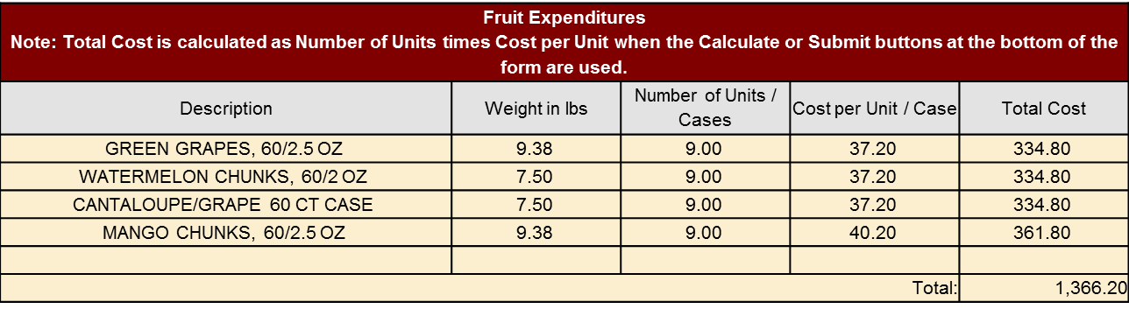
CLAIMS PROCESS
Fruit & Vegetable Expenditures:
  Description Column: Provide the fruit/vegetable ordered along with amount per case and/or unit size

Slide 31
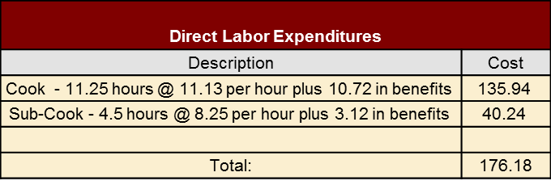
CLAIMS PROCESS
Direct Labor Costs:
  Employees related to the preparation and service of fruits & vegetables.
    If delivering from central kitchen (or delivery site) to district schools, the costs for driver and fuel costs
  In Description…include employee title, hours worked, rate of pay + fringe benefits if being claimed

Slide 32

CLAIMS PROCESS
Supply Expenditures:
  Non-food supplies that can be claimed include:
    Paper plates, bowls, and napkins
      Paper cups cannot be claimed unless replacing bowls and plates for smaller portions for youngest students
    Sporks, spoons, or forks
    Cleaning supplies and trash bags
  Cost of non-food combined with direct labor costs cannot exceed 25% of school’s FFVP allotment

Slide 33
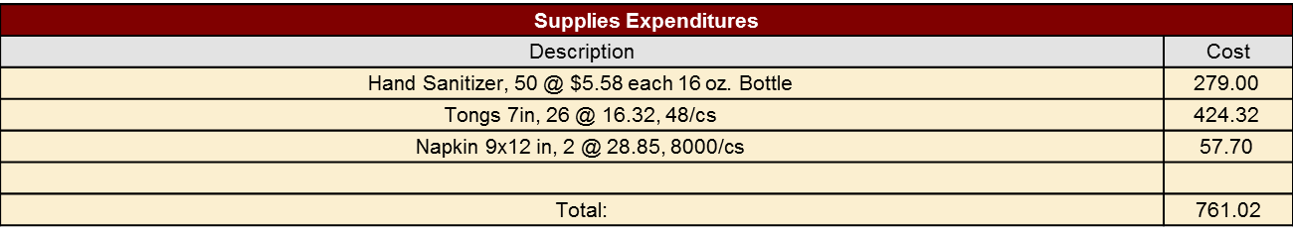
CLAIMS PROCESS
Make sure to include the following in description
  Item being ordered and number ordered
  Price and unit or case size

Slide 34
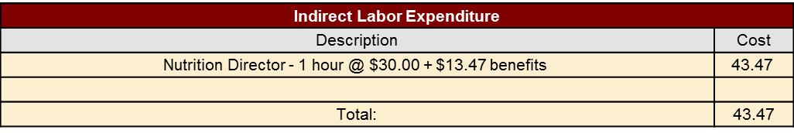
CLAIMS PROCESS
Indirect Labor Expenditure:
  This is where your administrative costs and equipment costs are claimed
  Description to include: title, hours worked, and rate of pay + any benefits being claimed
  Administrative Costs cannot exceed 10% of the schools total FFVP allotment.

Slide 35
CLAIMS PROCESS
Equipment Purchase Policy:
  Before ordering equipment, district must submit a written request to State Agency for approval on district letterhead.
    Need to include reason/need for equipment as well as breakout of equipment specs and cost
    If 100% of costs paid with FFVP funds, then equipment cannot be shared with other school feeding programs
    If equipment shared, the cost needs to be prorated

Slide 36
CLAIMS PROCESS
Approved equipment is claimed in the Equipment Expenditure section in CNP
  In Description, provide name and item spec. description, quantity, and cost
Remember…the cost of equipment factors into your 10% Admin (indirect) labor costs for each schools FFVP allotment

Slide 37
CLAIMS PROCESS
Expense Summary:
  Remember that allotments for each school are broken into two award periods.
    July – Sept: This award period is usually one months worth of overall award for each school; can request more if needed in writing w/reason for request
    Oct – Jun: Remaining total award funds
  Need to be careful to not overspend first award period. Expense Summary and Historical Summary will help you keep track

Slide 38
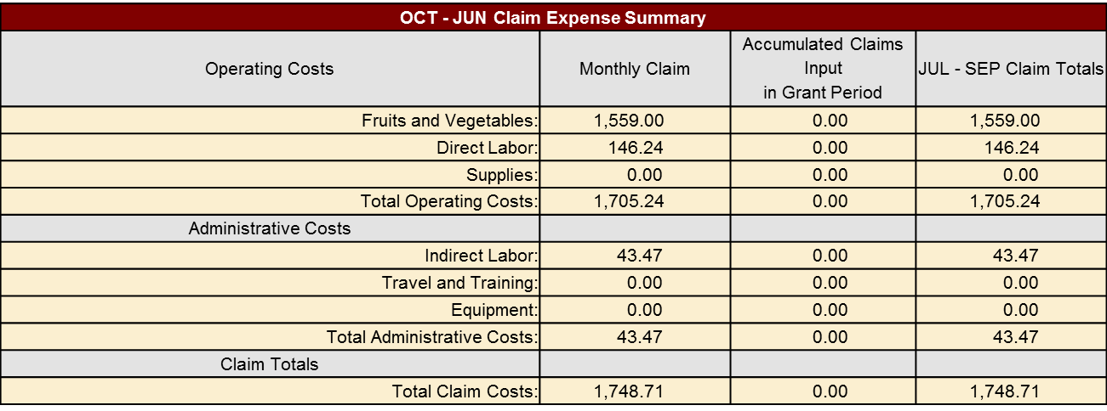
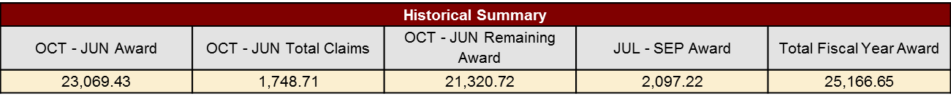
CLAIMS PROCESS

Slide 39
CLAIMS PROCESS
Site Claim:
  Claims for each school site are entered first
    The CNP program will time-out after 30 minutes. Save work frequently to prevent loss of data
  After everything if correctly entered, make sure to click the submit button
    Save button does not submit the claim

Slide 40
CLAIMS PROCESS
Consolidated Claim:
  Once all the site claims are submitted, the claim needs to be consolidated
    The consolidated screen will appear with all data fields populated based on the individual school site claims
    Review for accuracy, select authorized signer from drop down menu at the top of the claim form
      Must match name in the created by at bottom

Slide 41
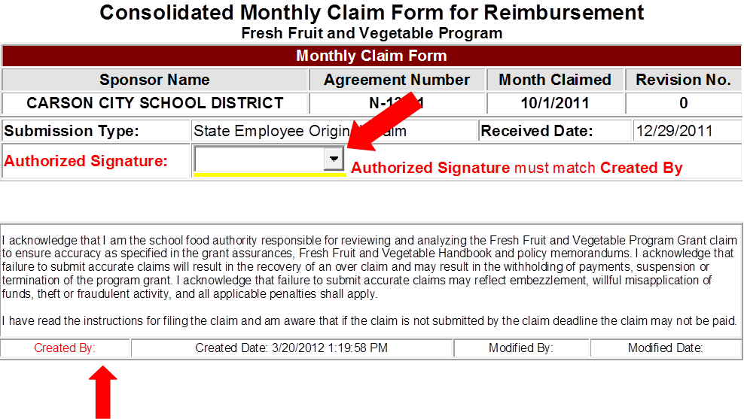

CLAIMS PROCESS

Slide 42
SUPPORTING DOCUMENTATION OF COSTS
To support the amounts being claimed for reimbursement full and accurate records must be maintained
Records kept for 3 years plus the current fiscal year
  Purchase orders & invoices
  Receipts
  Time-in-effort records
  Monthly FFVP service calendars (if used)
Notes:
It is required that all costs are accurately documented and supported.
Time & Effort reporting is a process mandated by the federal government to verify that direct labor charges (salaries and wages) to federally sponsored projects are reasonable and reflect actual work performed.
As a recipient of federal funds, reporting obligations are designed to ensure that the charges to FFVP are allowable and properly allocable to the program.

Slide 43

FFVP FILE
A copy of your Application and Agreement
  Addendums
Purchasing/Procurement information
Production records (if used)
Calendars – Educational Activities(if used)
Financial tracking of grant funds
Staff training records on the FFVP
FFVP Handbook
Policy Memoranda
Notes:
You need to keep a FFVP file containing all documents related to this program.
It is important for the schools themselves to keep a file as well as a file on the district level.
FFVP reviews are conducted in conjunction with a NSLP review at the school level, and therefore, documentation to review the program must be available for review at the school.
The individual schools awarded the grants will want to keep a copy on file of the supporting documentation for the monthly expenditure reports, the purchasing and procurement information if executed on the school level, report of that school’s activities in relation to the program, production records, documentation of the school’s training, financial tracking of grant funds and the FFVP handbook.
At the district level, you may want to maintain a copy of all of the above for your records and additionally you need to include a copy of your application and agreement for the program and any corresponding policies and memos related to the program.

Slide 44
PRODUCTION RECORDS
Schools opting for on-site preparation can keep production records to document the date, serving time, food items, portion size, the number prepared, the number of portions served and the amount of leftovers.
Frequent serving of leftovers during a lunch or breakfast meal service is strongly discouraged (occasional option only to avoid waste).
Try to incorporate into another FFVP serving time.
Notes:
Production records can be kept daily of your fruit and vegetable offerings. These are similar to the production records you would use for NSLP but much simpler.
On the FFVP production record you can record the school’s name, the date, what is served, the number of portions and the portion size, the number served and the amount of leftovers.
It is okay to serve the leftovers at a breakfast or lunch period provided that it is a rare occurrence and the quantities are low.
You may want to document on the production record if the leftovers were discarded, served another day with the FFVP or if they were served out at a meal period.

Slide 45
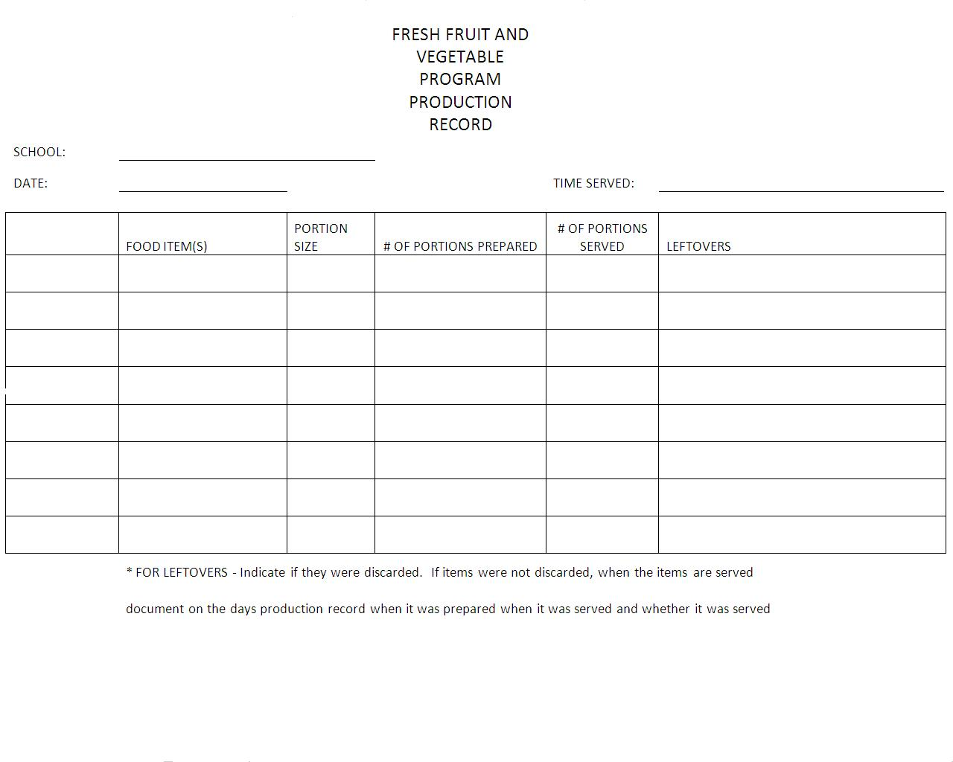
Notes:
This is required starting August / September 2014 (which ever month you start)

Slide 46
EDUCATIONAL ACTIVITIES
Document on the FFVP calendar the fruits and vegetables being offered, educational activities and materials provided.
This can be a useful tool to help in planning nutrition education to go with fresh fruits and vegetables being offered.
Can also be kept as part of records for easy reference on program implementation
Notes:
Nutrition education is an integral part of the FFVP.
Documentation of your educational offerings and materials provided to the students in conjunction with the FFVP can be documented on the calendar pages provided. You can also mark on the calendar what the offering was for that day as well.

Slide 47
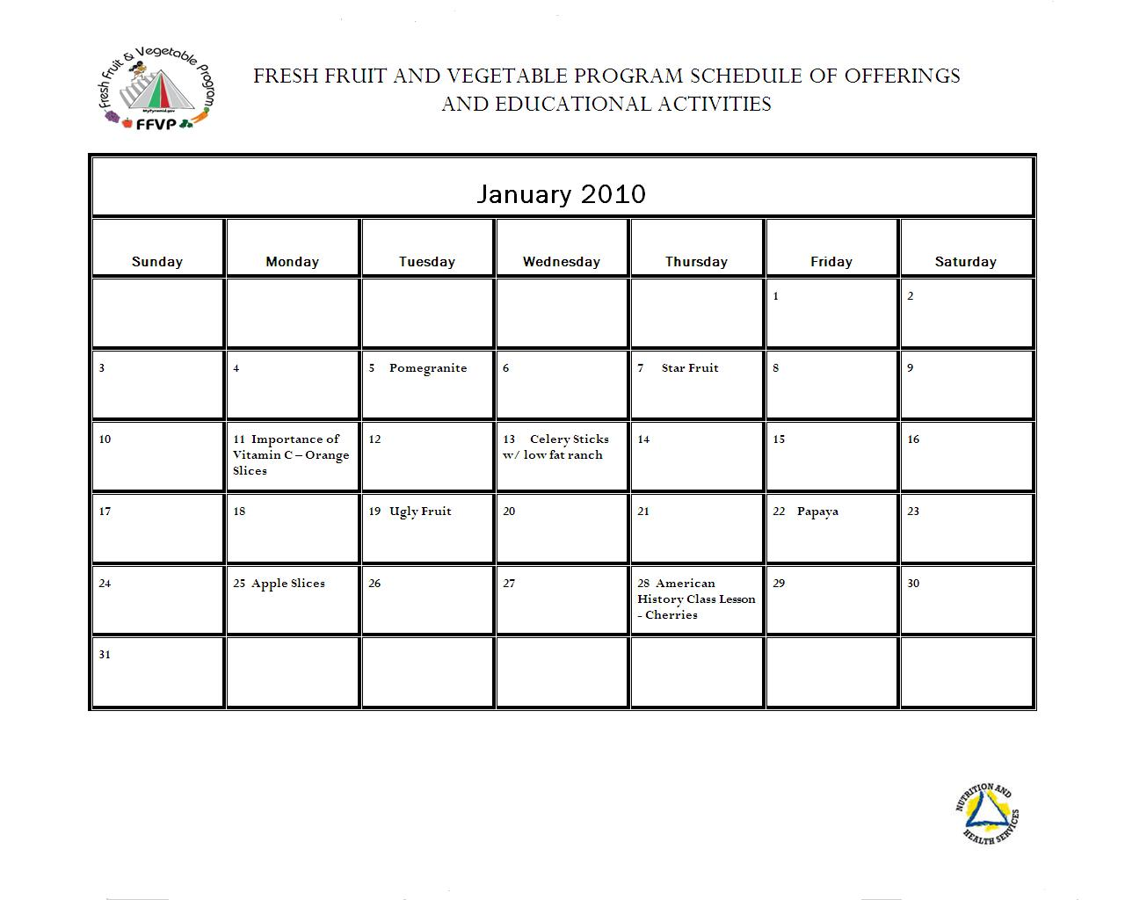

Notes:
On this example, you can see that on January 11th, there was an educational activity for Vitamin C.
In your binder behind January’s calendar page, you would insert a copy of the educational materials provided to students or a brief description of the education provided.
Print off a copy of the calendars from the website for each school in your district participating and keep on file at the school.

Slide 48

NUTRITION EDUCATION
  Education plans should fit your students
  Use free resources from Team Nutrition and other programs
  Create partnerships to obtain no cost promotional items or services
  Adapt lesson plans in classrooms to incorporate the serving of the fresh fruits and vegetables
Notes:
The primary focus of the FFVP is to bring fresh produce into the school for distribution to the children.
For too many children, the produce they see in school might be their first exposure to fresh fruits and vegetables, and the only ones they will see that day.
Nutrition education is critical to the program’s success.

Slide 49

NUTRITION EDUCATION RESOURCES
As the old saying goes… let not reinvent the wheel
Resource materials are available on NDA’s website, under child nutrition – FFVP
  http://nutrition.nv.gov/Resources/Fruit_and_Vegetable_Resources/
This does not mean that you are limited to these sources. Feel free to locate and develop your own as well

Slide 50
PROMOTING
Advertise and promote within the school
  Morning announcements
  Posters
Provide overview to staff
  Can utilize short Training Presentation PPTs
Promote with parents
  School Website
  Incorporate into school newsletter
  Parent Teacher Conferences
  PTA / PTO

Slide 51
PARTNERING
Partnerships are essential to success
  Internal: Encourage cooperation and commitment from school staff
    Don’t leave it to one person to manage
    Make it a team effort from principal down to custodial staff
  External: Develop new partnerships
    State and national associations
    State, County, or Community health agencies
    Dieticians and dietetic interns (UNR/TMCC)
    Produce associations/commodity groups
    Local farmers / grocers
    Service organizations (ie) Rotary, Kiwanis, etc.
    Non-profits with food/low-income service model
    Food Distributors
Notes:
Schools need to develop a sense of teamwork and staff buy-in to make FFVP as smooth and successful as possible
Schools are recommended to develop partnerships with one or more entities that will provide non-Federal resources and support.
Includes entities representing the fruit and vegetable industry as well as others working to promote children’s health in the community

Slide 52

REVIEWS FOR THE FFVP
Reviews of the FFVP are now performed in conjunction with your NSLP review.
A review can still be performed even if you are not up for your NSLP review.
Program compliance, record keeping, educational activities and the overall implementation of your program will be evaluated.
Notes:
Districts that are up for a NSLP review will have a FFVP school reviewed for the FFVP at that time.
If it is a non-review year for your district, we may come and observe one of your meal service times and offer technical assistance as well.
During a formal FFVP review, we will be looking at your compliance of the program such as filing, the planning of your program, school involvement, the educational offerings used in conjunction with the program, making sure your record keeping is comprehensive and how well your program is running overall.

Slide 53

IN CLOSING
Each year - eligible elementary schools will receive a letter of invitation along with the current application for the FFVP grant
Schools invited to apply for the FFVP grant will have approximately 6 weeks to respond to the Request for Proposal by submitting a grant application
Schools selected to participate in the FFVP will receive per-student allocation of $50-$75 per year
Notes:
Schools eligible for the FFVP must meet the following criteria:
Elementary School (Grades K-8 including children enrolled in Head Start, a split-session kindergarten or a child care center located in the eligible school)
Participate in the National School Lunch Program
At least 50 percent of the students are eligible for the free/reduced price meals.
Schools with the highest free/reduced price eligible students will be given priority.
Complete an annual application for the FFVP

Slide 54

QUESTIONS?

